Slide 1
There are many types of operators in Java which are given below:
Unary Operator,
Arithmetic Operator,
Shift Operator,
Relational Operator,
Bitwise Operator,
Logical Operator,
Ternary Operator and
Assignment Operator.

Slide 2
Java Unary Operator
The Java unary operators require only one operand. Unary operators are used to perform various operations i.e.:
incrementing/decrementing a value by one
negating an expression
inverting the value of a boolean

Slide 3
Java Unary Operator
– : Unary minus, used for negating the values.
+ : Unary plus indicates the positive value (numbers are positive without this, however). It performs an automatic conversion to int when the type of its operand is the byte, char, or short. This is called unary numeric promotion.
++ : Increment operator, used for incrementing the value by 1. There are two varieties of increment operators.
Post-Increment: Value is first used for computing the result and then incremented.
Pre-Increment: Value is incremented first, and then the result is computed.
— : Decrement operator, used for decrementing the value by 1. There are two varieties of decrement operators.
Post-decrement: Value is first used for computing the result and then decremented.
Pre-Decrement: Value is decremented first, and then the result is computed.
! : Logical not operator, used for inverting a boolean value.

Slide 4
Java Unary Operator
public class OperatorExample{
public static void main(String args[]){
int x=10;
System.out.println(x++);//10 (11)
System.out.println(++x);//12
System.out.println(x--);//12 (11)
System.out.println(--x);//10
}}
Output:
10
12
12
10

Slide 5
Java Unary Operator
public class OperatorExample{
public static void main(String args[]){
int a=10;
int b=10;
System.out.println(a++ + ++a);//10+12=22
System.out.println(b++ + b++);//10+11=21
}}
Output:
22
21

Slide 6
Java Unary Operator
Adil Aliyev's blog — What "~" (tilde) operator does in Java
Java Unary Operator Example: ~ and !
public class OperatorExample{
public static void main(String args[]){
int a=10;
int b=-10;
boolean c=true;
boolean d=false;
System.out.println(~a);//-11
System.out.println(~b);//9
System.out.println(!c);//false (opposite of boolean value)
System.out.println(!d);//true
}}

Slide 7
Java Arithmetic Operator Example
1. Arithmetic Operators: They are used to perform simple arithmetic operations on primitive data types.
* : Multiplication
/ : Division
% : Modulo
+ : Addition
– : Subtraction

Slide 8
Java Arithmetic Operator Example
public class OperatorExample{
public static void main(String args[]){
int a=10;
int b=5;
System.out.println(a+b);//15
System.out.println(a-b);//5
System.out.println(a*b);//50
System.out.println(a/b);//2
System.out.println(a%b);//0
}}
15
5
50
2
0

Slide 9
Java Arithmetic Operator Example
public class OperatorExample
{
public static void main(String args[])
{
System.out.println(10*10/5+3-1*4/2);
}
}
OUTPUT
21

Slide 10
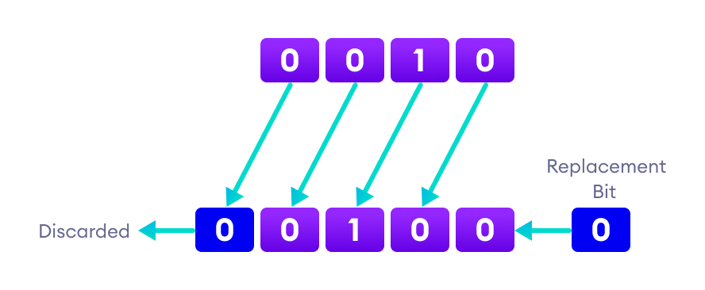
Java Shift Operators
There are three types of shift operators in Java:
Signed Left Shift (<<)
Signed Right Shift (>>)
Unsigned Right Shift (>>>)
Java Left Shift Operator

Slide 11
Java Shift Operators
There are three types of shift operators in Java:
Signed Left Shift (<<)
Signed Right Shift (>>)
Unsigned Right Shift (>>>)
Java Left Shift Operator

Slide 12
Java Left Shift Operator
The Java left shift operator << is used to shift all of the bits in a value to the left side of a specified number of times. b = a<<n = a*(2^n)
public class OperatorExample{
public static void main(String args[]){
System.out.println(10<<2);//10*2^2=10*4=40
System.out.println(10<<3);//10*2^3=10*8=80
System.out.println(20<<2);//20*2^2=20*4=80
System.out.println(15<<4);//15*2^4=15*16=240
}}

Slide 13
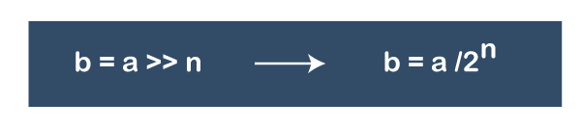
Java Right Shift Operator
The Java right shift operator >> is used to move the value of the left operand to right by the number of bits specified by the right operand..
public OperatorExample{
public static void main(String args[]){
System.out.println(10>>2);//10/2^2=10/4=2
System.out.println(20>>2);//20/2^2=20/4=5
System.out.println(20>>3);//20/2^3=20/8=2
}}

Slide 14
Java Logical Operators

Slide 15
Java Logical Operators
Java AND Operator Example: Logical && and Bitwise &
The logical && operator doesn't check the second condition if the first condition is false. It checks the second condition only if the first one is true.
The bitwise & operator always checks both conditions whether first condition is true or false.
public class OperatorExample{
public static void main(String args[]){
int a=10;
int b=5;
int c=20;
System.out.println(a<b&&a<c);//false && true = false
System.out.println(a<b&a<c);//false & true = false
}}

Slide 16
Java AND Operator Example: Logical && vs Bitwise &
public class OperatorExample{
public static void main(String args[]){
int a=10;
int b=5;
int c=20;
System.out.println(a<b&&a++<c);//false && true = false
System.out.println(a);//10 because second condition is not checked
System.out.println(a<b&a++<c);//false && true = false
System.out.println(a);//11 because second condition is checked
}}

Slide 17
Java OR Operator Example: Logical || and Bitwise |
The logical || operator doesn't check the second condition if the first condition is true. It checks the second condition only if the first one is false.
public class OperatorExample{
public static void main(String args[]){
int a=10;
int b=5;
int c=20;
System.out.println(a>b||a<c);//true || true = true
System.out.println(a>b|a<c);//true | true = true
//|| vs |
System.out.println(a>b||a++<c);//true || true = true
System.out.println(a);//10 because second condition is not checked
System.out.println(a>b|a++<c);//true | true = true
System.out.println(a);//11 because second condition is checked
}}

Slide 18
Java Ternary Operator
public class OperatorExample{
public static void main(String args[]){
int a=2;
int b=5;
int min=(a<b)?a:b;
System.out.println(min);
}}
OUTPUT :2

Slide 19
Java Assignment Operator Example
+=, for adding left operand with right operand and then assigning it to the variable on the left.
-=, for subtracting right operand from left operand and then assigning it to the variable on the left.
*=, for multiplying left operand with right operand and then assigning it to the variable on the left.
/=, for dividing left operand by right operand and then assigning it to the variable on the left.
%=, for assigning modulo of left operand by right operand and then assigning it to the variable on the left.

Slide 20
Java Assignment Operator Example
public class OperatorExample{
public static void main(String[] args){
int a=10;
a+=3;//10+3
System.out.println(a);
a-=4;//13-4
System.out.println(a);
a*=2;//9*2
System.out.println(a);
a/=2;//18/2
System.out.println(a);
}}

Slide 21
Java Bitwise Operators

Slide 22
Java Bitwise Operators

Slide 23
Java Bitwise Operators
Bitwise OR
class Main {
public static void main(String[] args) {
int number1 = 12, number2 = 25, result;
// bitwise OR between 12 and 25
result = number1 | number2;
System.out.println(result); // prints 29
}
}

Slide 24
Java Bitwise Operators
Java Bitwise AND Operator

Slide 25
Java Bitwise Operators
Java Bitwise AND Operator
class Main {
public static void main(String[] args) {
int number1 = 12, number2 = 25, result;
// bitwise AND between 12 and 25
result = number1 & number2;
System.out.println(result); // prints 8
}
}

Slide 26
Java Bitwise Operators
Java Bitwise XOR Operator

Slide 27
Java Bitwise Operators
Java Bitwise XOR Operator
class Main {
public static void main(String[] args) {
int number1 = 12, number2 = 25, result;
// bitwise XOR between 12 and 25
result = number1 ^ number2;
System.out.println(result); // prints 21
}
}

Slide 28
Java Bitwise Operators
Java Bitwise Complement Operator

Slide 29
Java Bitwise Operators
Java Bitwise Complement Operator

Slide 30
Java Relational Operators:
These operators are used to check for relations like equality, greater than, and less than. They return boolean results after the comparison and are extensively used in looping statements as well as conditional if-else statements. The general format is,
Some of the relational operators are-
==, Equal to returns true if the left-hand side is equal to the right-hand side.
!=, Not Equal to returns true if the left-hand side is not equal to the right-hand side.
<, less than: returns true if the left-hand side is less than the right-hand side.
<=, less than or equal to returns true if the left-hand side is less than or equal to the right-hand side.
>, Greater than: returns true if the left-hand side is greater than the right-hand side.
>=, Greater than or equal to returns true if the left-hand side is greater than or equal to the right-hand side.

